Slide 1
Passive Filters
Chapter 14

Slide 2
Passive Filters
A filter is a circuit that is designed to pass signals with desired frequencies and reject or attenuate others.
Filters are the circuits used in radio and TV receivers to allow us to select one desired signal out of a multitude of broadcast signals in the environment.
A filter is a passive filter if it consists of only passive elements R, L, and C. It is said to be an active filter if it consists of active elements (such as transistors and op amps) in addition to passive elements R, L, and C.

Slide 3
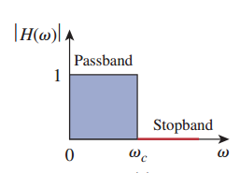
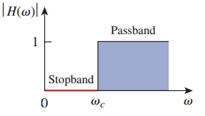
A highpass filter passes high frequencies and rejects low frequencies, as shown ideally in Fig.
A lowpass filter passes low frequencies and stops high frequencies, as shown ideally in Fig

Slide 4
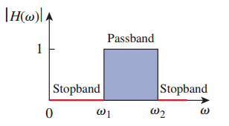
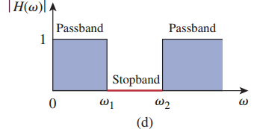
A bandpass filter passes frequencies within a frequency band and blocks or attenuates frequencies outside the band, as shown ideally in Fig.
A bandstop filter passes frequencies outside a frequency band and blocks or attenuates frequencies within the band, as shown ideally in Fig.

Slide 5
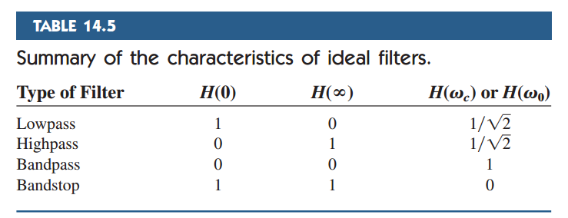

Slide 6
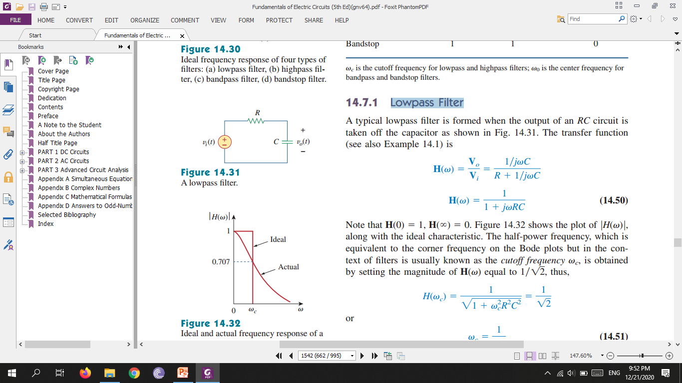
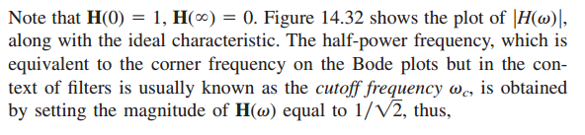
Lowpass Filter
A typical lowpass filter is formed when the output of an RC circuit is taken off the capacitor

Slide 7
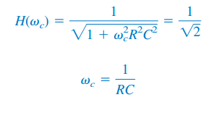
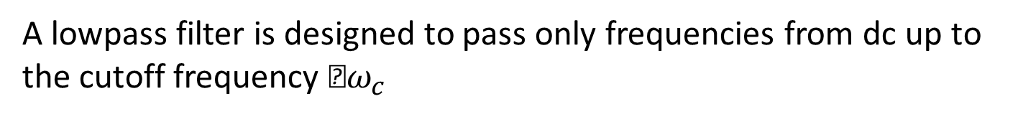
A lowpass filter is designed to pass only frequencies from dc up to the cutoff frequency $ω_{c}$

Slide 8
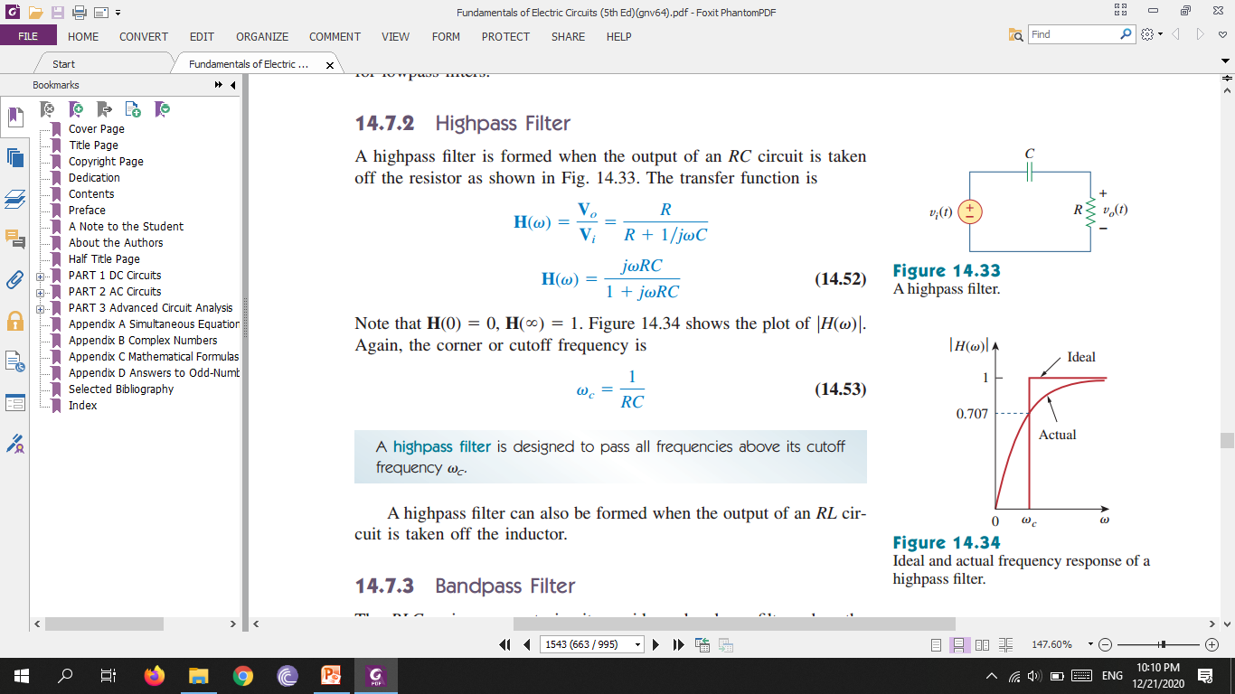
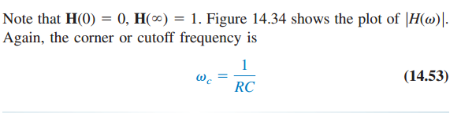
Highpass Filter
A highpass filter is formed when the output of an RC circuit is taken off the resistor

Slide 9
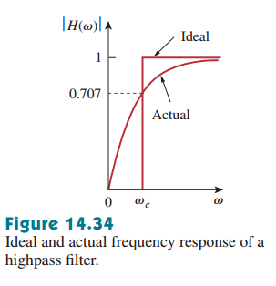
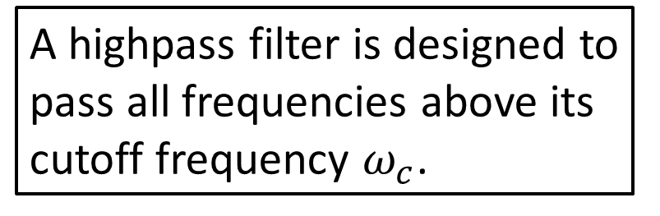
A highpass filter is designed to pass all frequencies above its cutoff frequency $ω_{c}$.

Slide 10
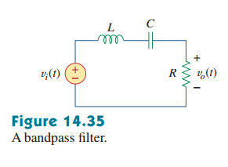
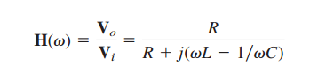
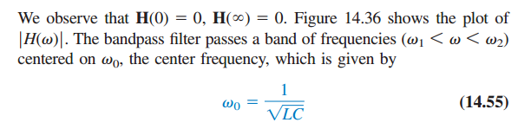
Bandpass Filter
The RLC series resonant circuit provides a bandpass filter when the output is taken off the resistor

Slide 11
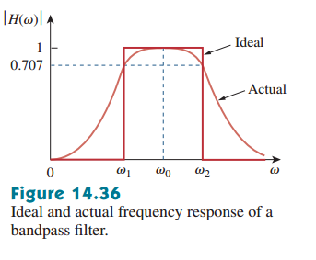
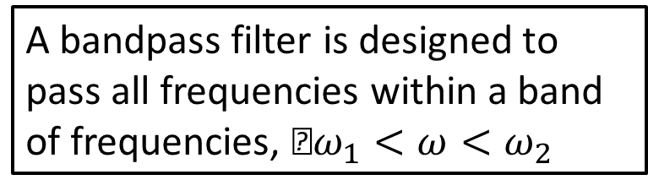
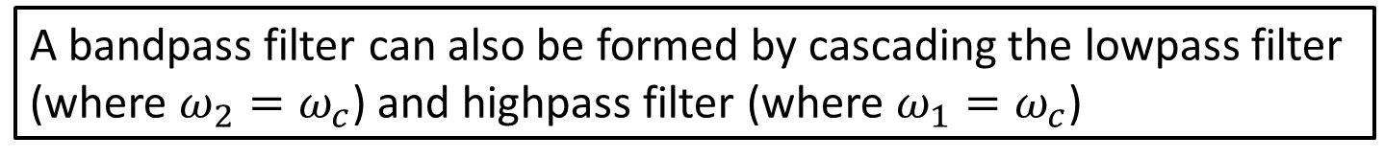
A bandpass filter is designed to pass all frequencies within a band of frequencies, $ω_{1}<ω<ω_{2}$
bandpass filter, is a series resonant circuit.
Bandwidth and quality factor.
A bandpass filter can also be formed by cascading the lowpass filter (where $ω_{2}=ω_{c}$) and highpass filter (where $ω_{1}=ω_{c}$)

Slide 12
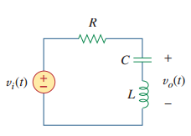
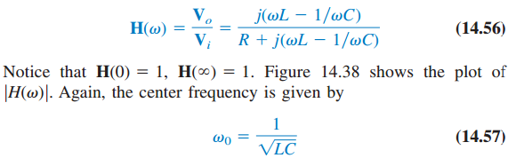
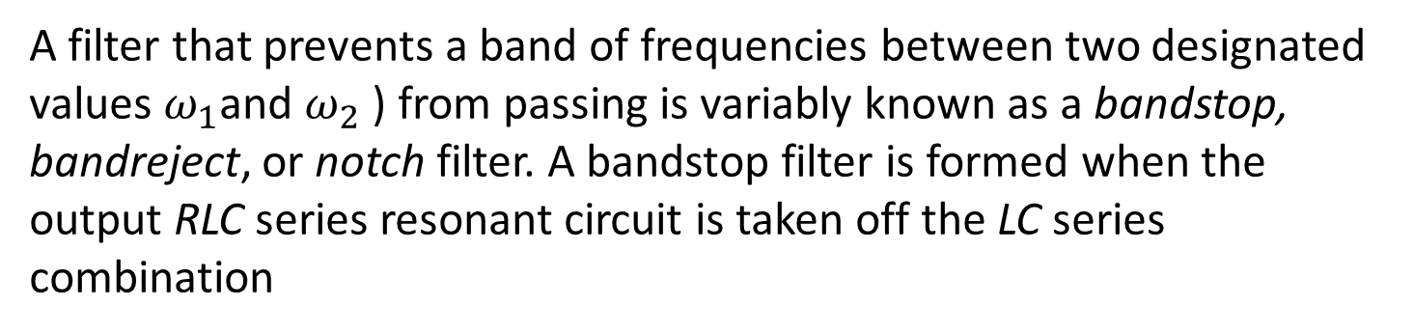
Bandstop Filter
A filter that prevents a band of frequencies between two designated values $ω_{1}$and $ω_{2}$ ) from passing is variably known as a bandstop, bandreject, or notch filter. A bandstop filter is formed when the output RLC series resonant circuit is taken off the LC series combination

Slide 13
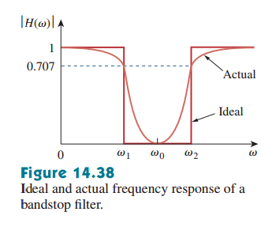
Bandwidth of rejection.
the maximum gain of a passive filter is unity. To generate a gain greater than unity, one should use an active filter

